Slide 1
Evaluation of patient reidentification using laboratory test orders and mitigation via latent space variables
Kipp Johnson
November 7th, 2018

Slide 2
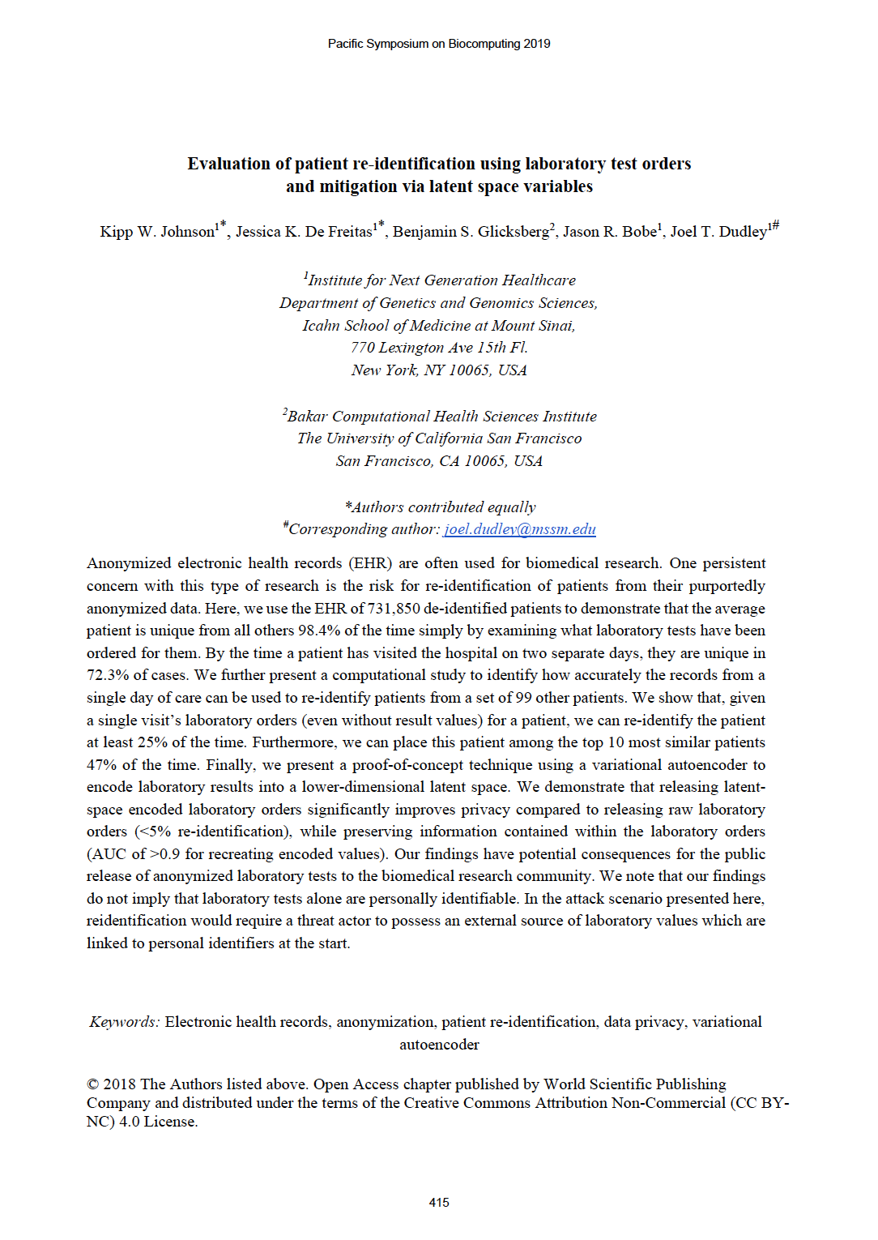
Jessica K. De Freitas
Benjamin S. Glicksberg
Jason R. Bobe
Joel T. Dudley

Slide 3
Anonymity

Slide 4
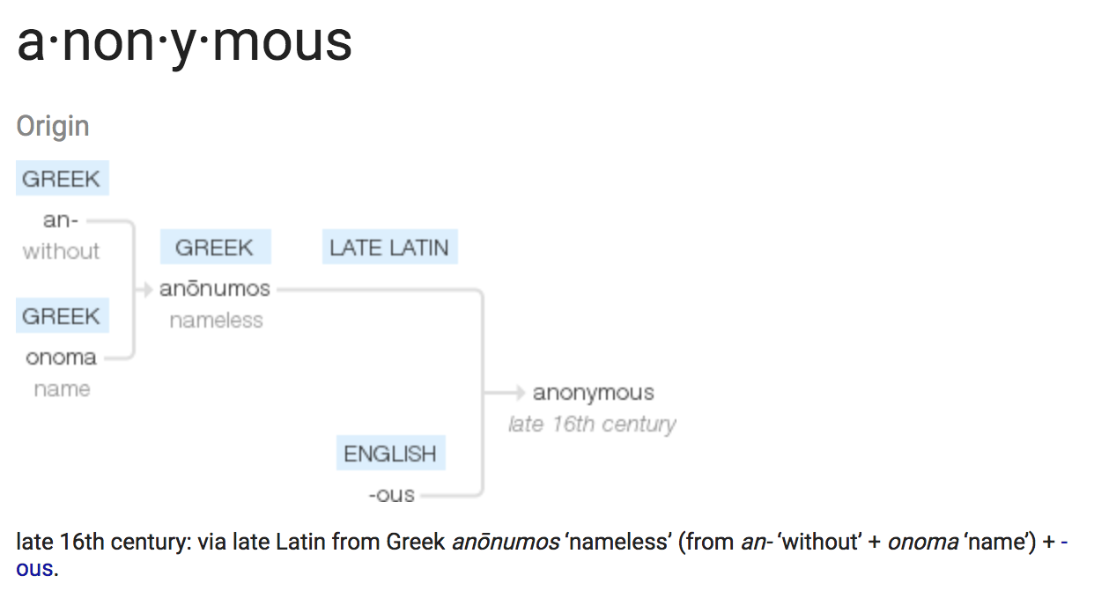
=
having the quality of being
without name

Slide 5
How can we anonymize health records for research purposes?
… remove the patients’ names?

Slide 6
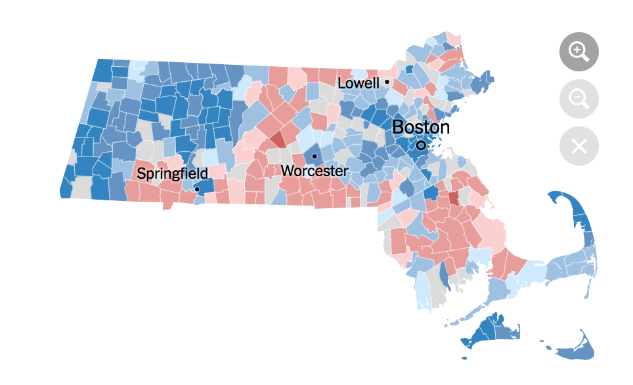
To understand why this might not work, consider the case of:
Massachusetts, 1997

Slide 7
In 1997, the Massachusetts Group Insurance Commission (GIC) had an idea to help health researchers make new discoveries:
GIC would anonymize and release all insurance data for the state of Massachusetts
This would include patient-level diagnoses and billing codes, medication prescriptions, surgical procedures, etc.
Anonymization of dataset would remove all personal identifiers such as names, street addresses, etc.

Slide 8
PhD Student at MIT in 1997
William Weld
Latanya Sweeney, PhD
Governor of Massachusetts in 1997

Slide 9
The GIC “anonymized dataset” contained the following variables:
Birth date
Only six individuals in Cambridge, MA shared Gov. Weld’s birth date
Gender
Only 3 of the 6 were male
Zip code
Only one lived in his particular zip code

Slide 10
With this information, Latonya Sweeney was able to identify Governor Weld’s complete health records
→ She then printed them out and mailed them to his office
Moral of the story:
“Anonymized” data often isn’t really anonymous

Slide 11
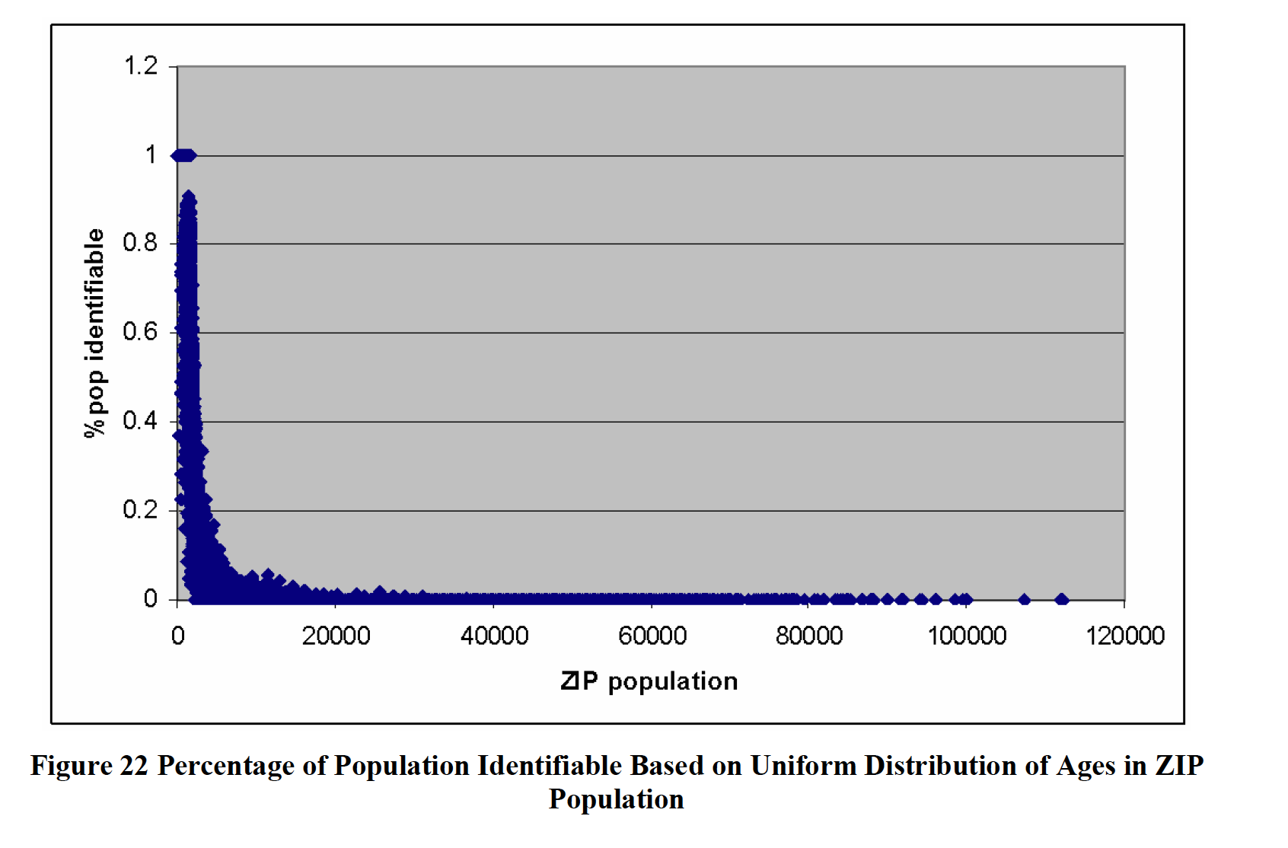
Sweeney’s later work demonstrated that ~87% of all people in the US are uniquely identifiable by combination of gender, birth date, and zip code

Slide 12
Medical Records
Diagnoses
Lab test results
Medications
Surgical Procedures
Physician notes
Imaging studies

Slide 13
Electronic Medical Records
Diagnoses
Lab test results
Medications
Surgical Procedures
Physician notes
Imaging studies

Slide 14


EHR/EMR data is often “anonymized” (deidentified) and used for research

Slide 15
Central question: How identifiable are individuals in the anonymized EHR?
Follow-up question: If patients are identifiable, can this be mitigated?

Slide 16
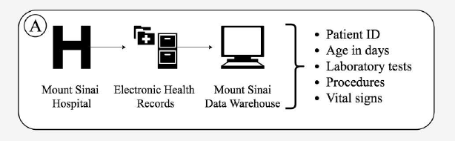
Examining the uniqueness of Mount Sinai EHR Data
We use an anonymized dataset of over 700,000 individuals
(At no point do we attempt to actually reidentify people)

Slide 17
Lab Tests in the EHR
Queried for all possible lab tests
Labs are identified by string names
2,635 different lab tests ordered with 342,485,583 laboratory test results
Mean of 468 results per patient
Corresponds to 6.5 million patient-days of history
Mean number of unique tests per patient: 49.8
Mean number of encounter days per patient: 8.8
218 lab tests ordered only once
1,186 lab tests ordered less than 1,000 times

Slide 18
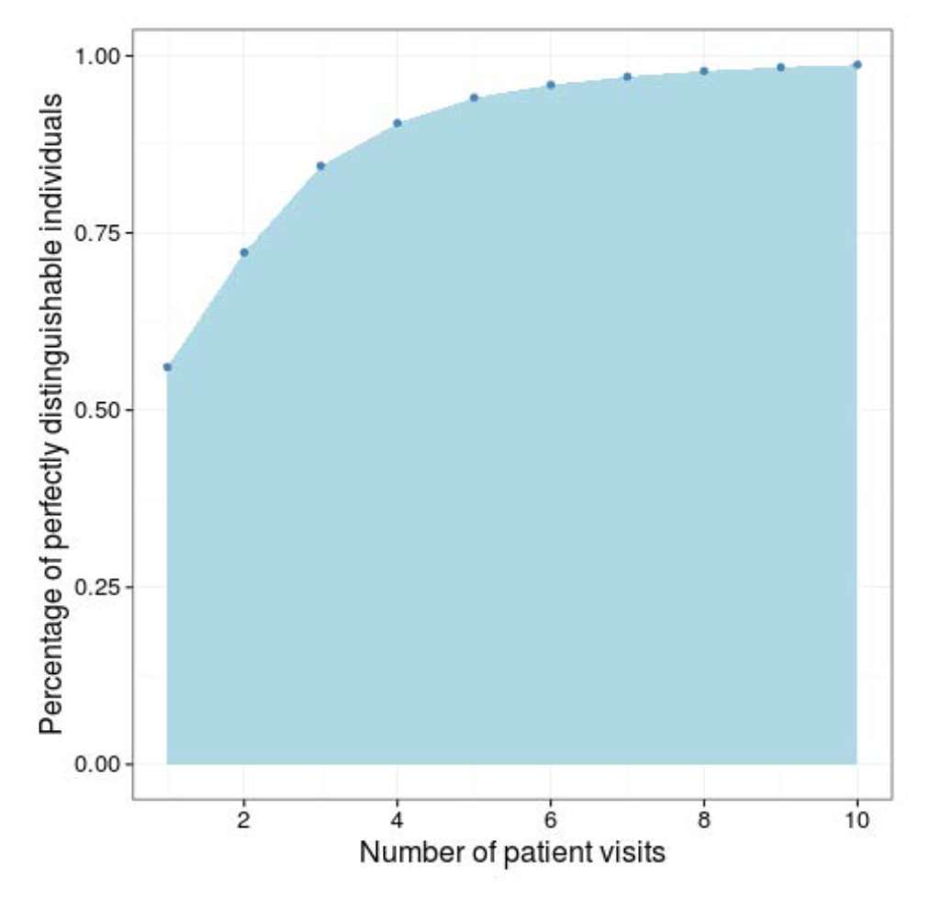
What percentage of patients can be uniquely identified by their lab tests?
56.1 % of patients have laboratory orders completely unique to them
Patients with 9 days of visits are unique from all other patients 98.4% of the time

Slide 19
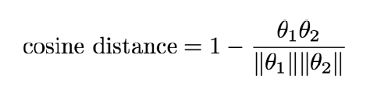
Can we reidentify patients with only 1 day of patient records?
Create patient-day lab vectors if lab was ordered for patient
θ = {1, 0, 0, 0, 1, … } where x_{i} is a binary indicator variable for if lab test was ordered for given patient on given day
Compute pairwise cosine distances between patient-day lab vectors

Slide 20
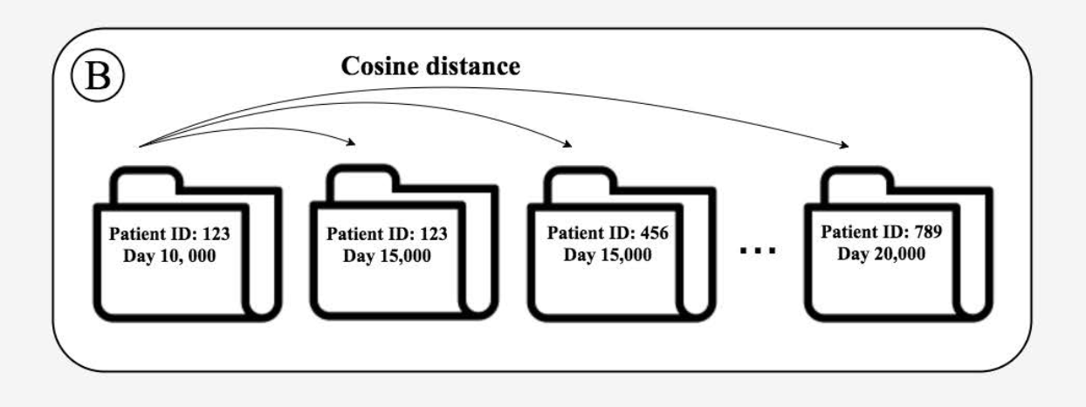
Reidentification attack setup and algorithm:
Randomly select one seed patient
Then randomly select one of this patient’s lab-day vectors
This is the “query vector”
Obtain all of this seed patient’s other lab-day vectors
Randomly select 99 other patients and obtain all of their lab-day vectors (“target vectors”)
Compute cosine distances between query vector and all other target vectors

Slide 21
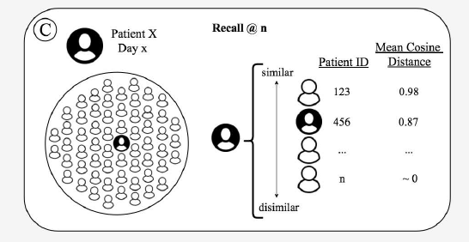
Reidentification attack setup and algorithm:
Compute mean cosine distances between the query vector and the vectors corresponding to other patients, as well as the seed patient’s other lab-day vectors
Rank resulting mean distances by similarity

Slide 22
Evaluating reidentification performance
Modification of recall@n metric commonly used in information retrieval literature
Essentially measures how far down the list of 100 individuals we need to go before we have the correct individual
Repeat entire algorithm 1000 times to obtain performance distributions
Recall @ n = 1: Patient’s other records are most similar (perfect match)
Recall @ n = 50: Patient’s other records are 50th most similar (of 100)
(Equivalent to random chance)

Slide 23
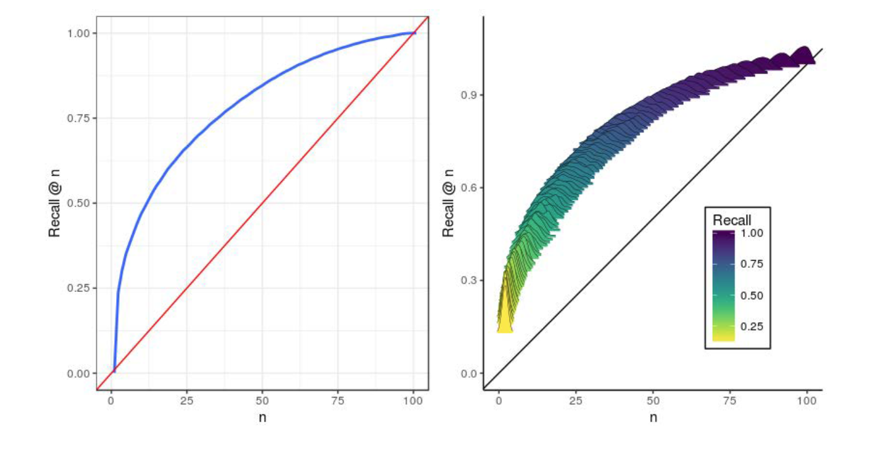
Reidentification results
Recall @ n=1 25% of the time
Recall @ n<10 47% of the time
Notes:
Area under curve corresponds to increased performance over randomness

Slide 24
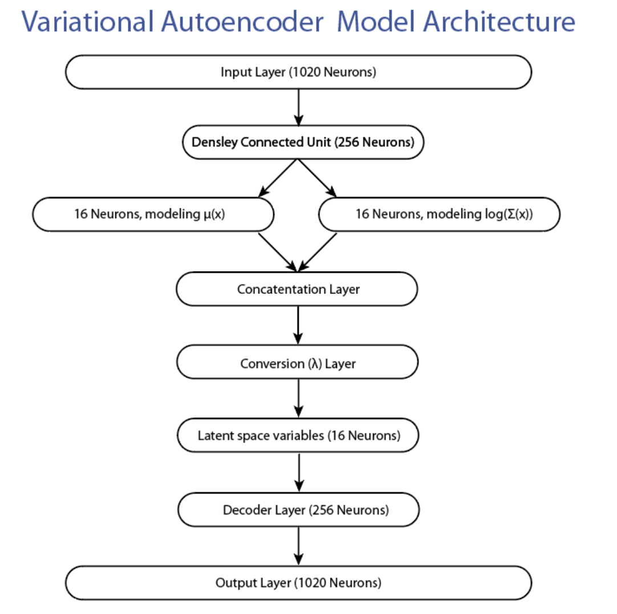
How can we mitigate reidentifiability?
Solution:
reduce lab tests into lower-dimensional latent space
Method:
variational autoencoder (VAE) with 16 latent neurons

Slide 25
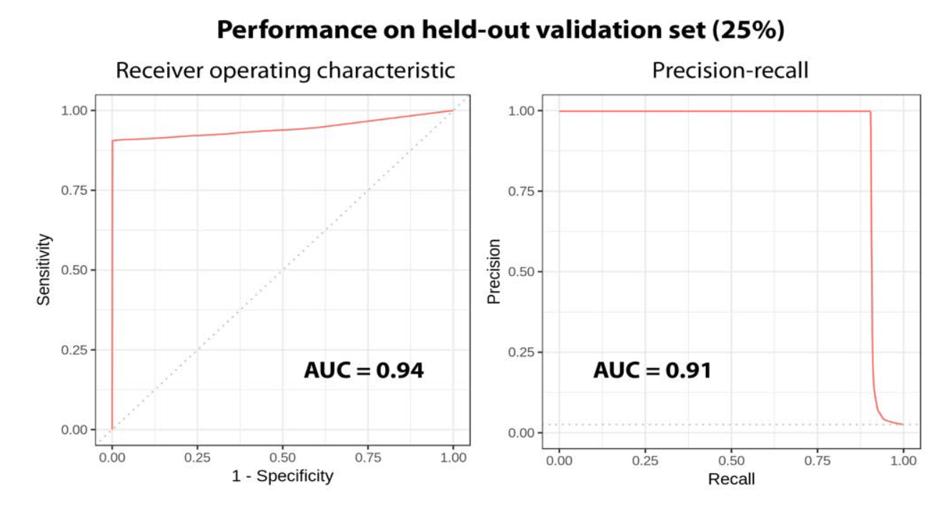
VAE recapitulates input data from encoded latent variables
Input data
Latent space variables
Output data

Slide 26
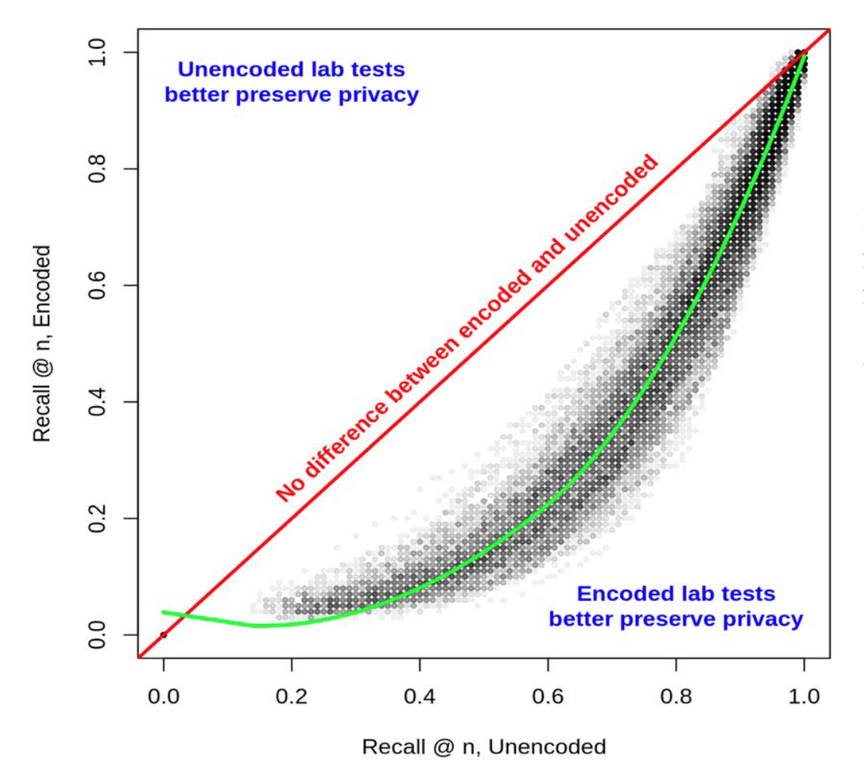
VAE-encoded data preserves privacy
Comparing recall@n performance between encoded and unencoded lab tests

Slide 27
Summary and Conclusions
Laboratory test ordering patterns are highly unique to patients
One day of lab test orders can often be used to match a patient from among 99 other patients
Encoding laboratory test orders into latent variables using a variational autoencoder can help to significantly mitigate reidentification risk

Slide 28





Questions?
Acknowledgements
Jessica K. De Freitas
Benjamin S. Glicksberg
Jason R. Bobe
Joel T. Dudley

